Slide 1
My cultural item
Presenter : Jack

Slide 2
It is a key ring.
鑰匙圈

Slide 3
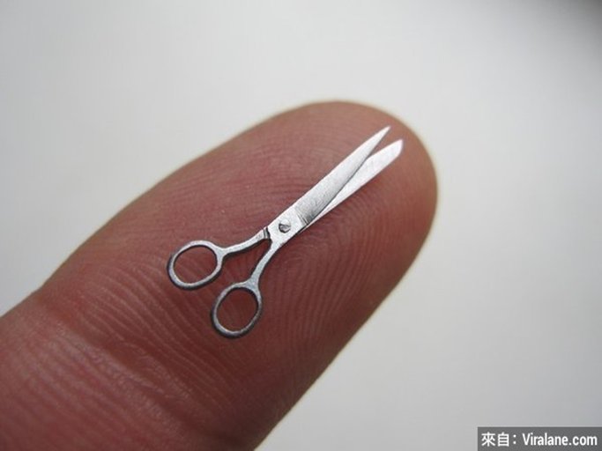
It is small.
它，很小

Slide 4
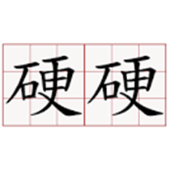
It feels hard.
而且很硬

Slide 5
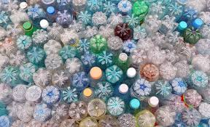
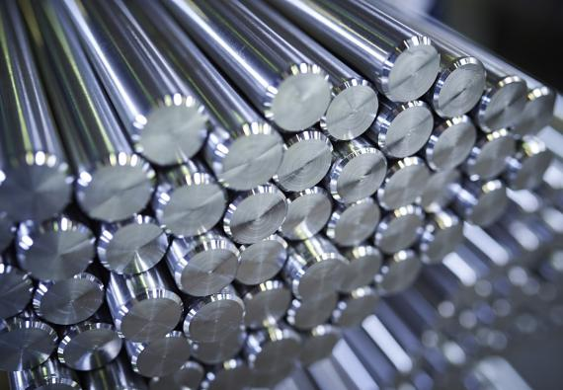
It is made of plastic and metal.
它由塑膠和金屬製成

Slide 6
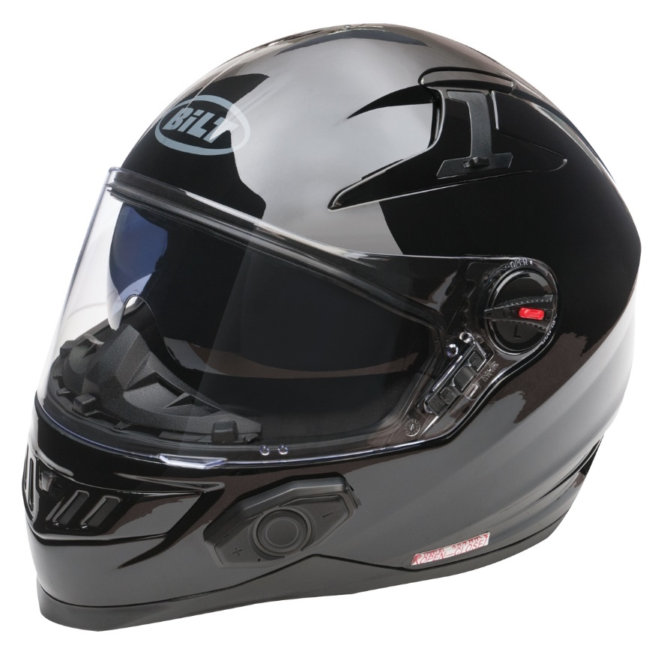
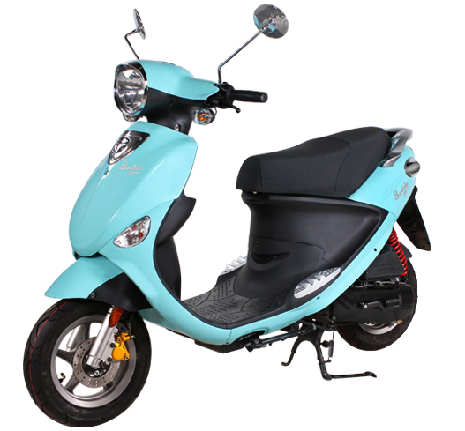
There are a metal ring, helmet and scooter .
上面有金屬環、安全帽和機車

Slide 7
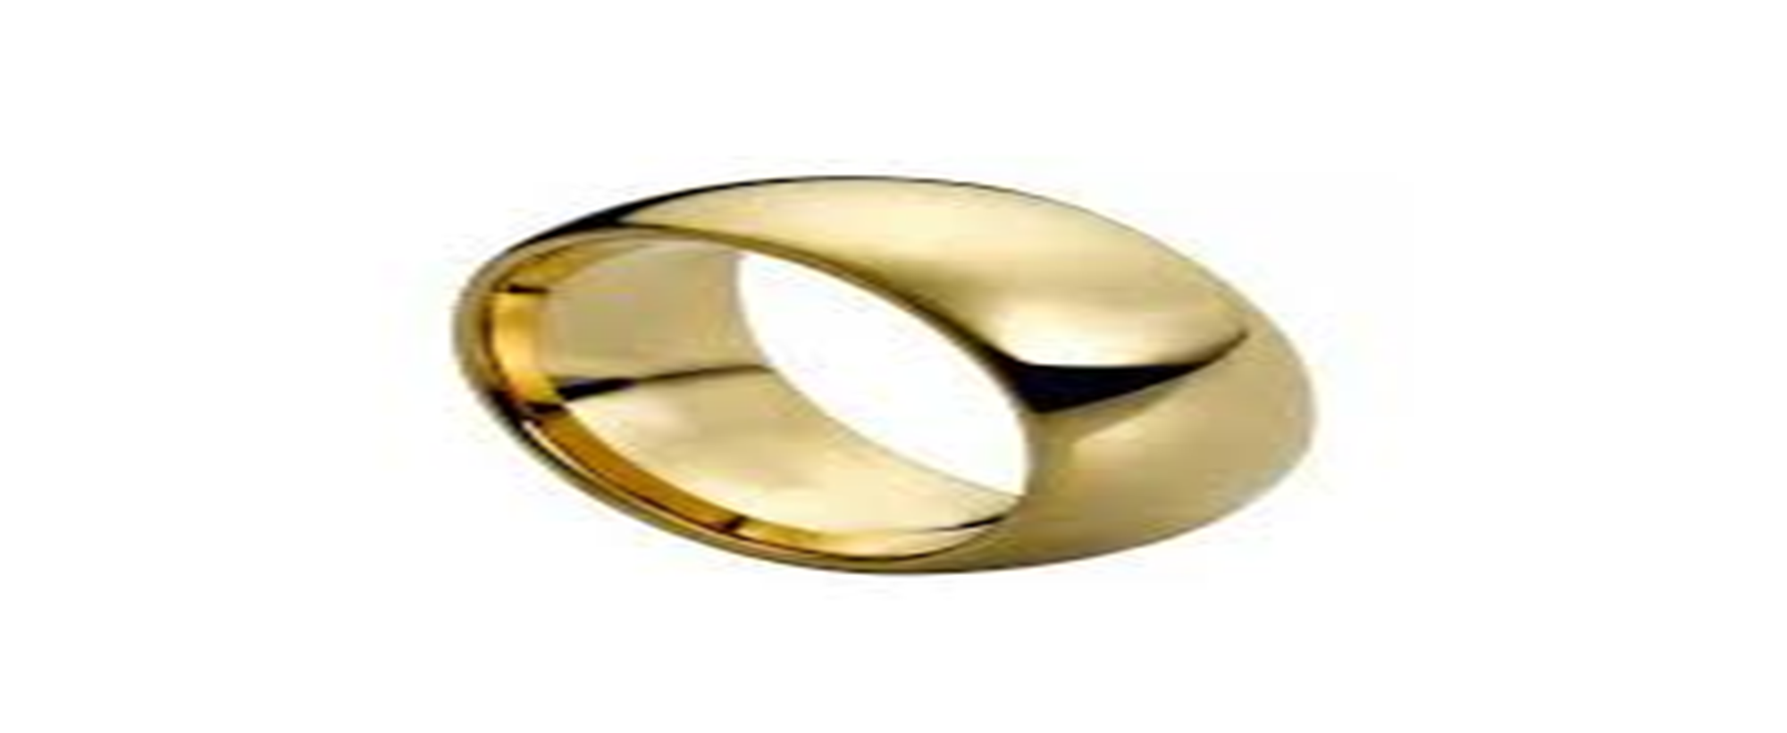
You can hang it on the key.可以掛鑰匙

Slide 8
???
???
???
???

Slide 9
Scooter keychain 機車鑰匙圈

Slide 10
It’s a Scooter Keychain

Slide 11
I think a scooter is very important in Taiwanese culture
機車對台灣文化是非常重要的

Slide 12
This is because scooters are everywhere in Taiwan.
因為台灣到處都有機車

